Slide 1

microServiceBus.com
tutorial
Mikael Hakansson
mikael.hakansson@axians.com

Slide 2
Axians IoT Nordic’s
take on IoT

Slide 3






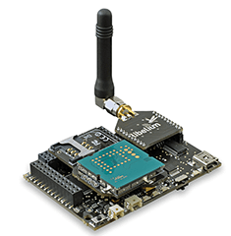





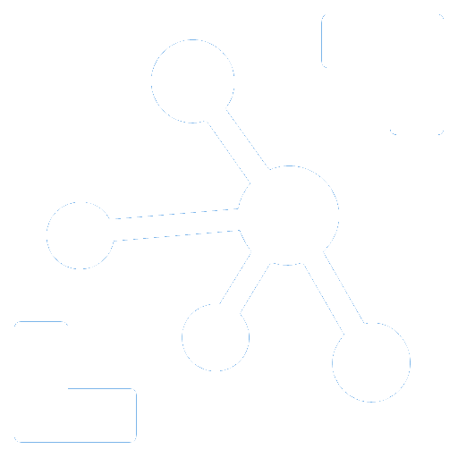







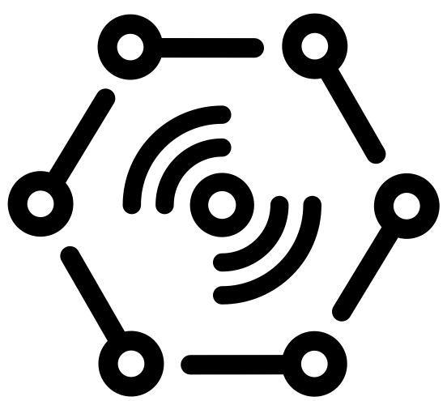





Challenges
Onboarding
Hub independence
Updates & Patches
Issue tracking
Monitoring
Reports
“Any DEvice”
Value
Apps
DATA
“Any Data Source”
“Any IoT platform”
Monitoring
“Any PROTOCOL”
Machine
Learning
PROTOCOL
DATA
LOB
Modbus
Wi-Fi
LoRa
Serial

Slide 4

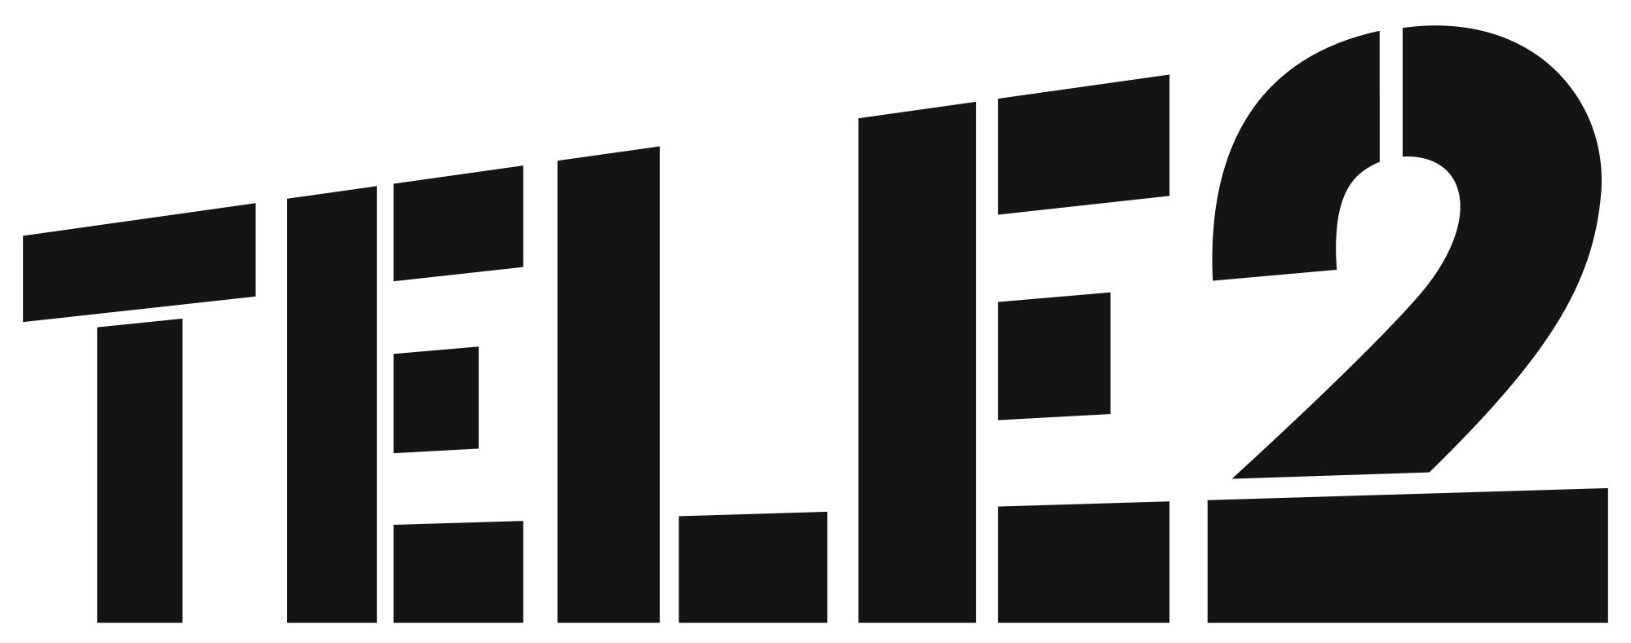



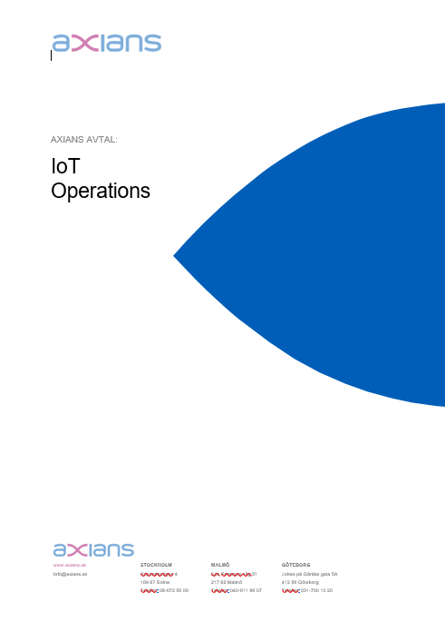
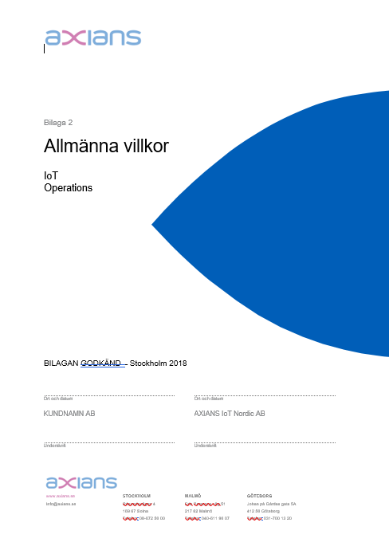
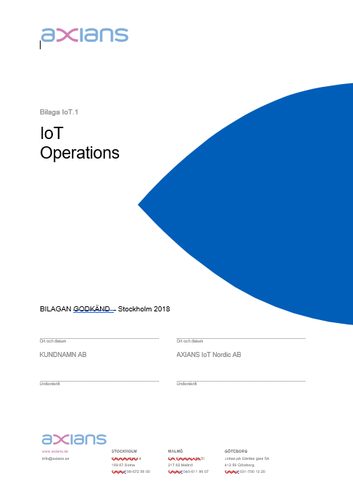
IoT Operations generic offering
IoT Nordic
PLC’s
Machines, Sensors,
meters etc...
Gateway (Devices)
Communi-cation
Cloud
IoT Operations
Business Solution
Set price per device & month.

Slide 5
Customer Response

Slide 6

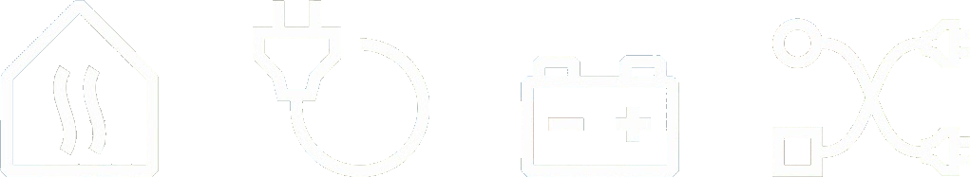

DES Business Platform
HEAT
POWER
CHARGE
SMART

Slide 7

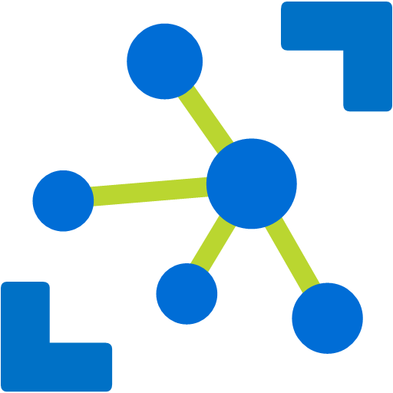












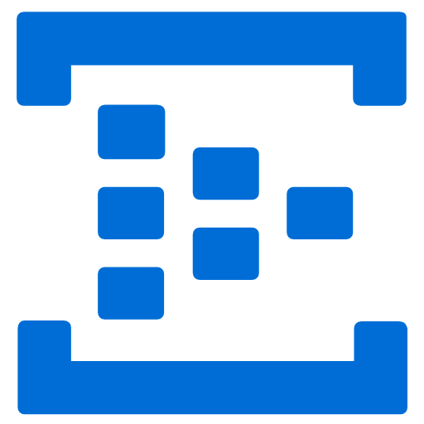


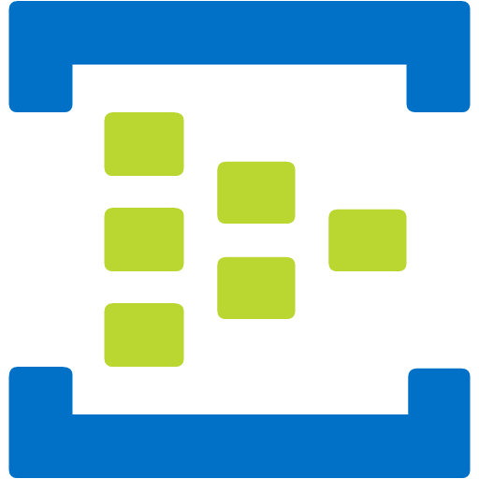





HEAT
POWER
CHARGE
METER
Power meter
IoT Hub
des.vattenfall.com
Power meter
DES Portal
Heat pump
//
Analysis storage
- decrypt
- de-batch
- ingest
Energy meter
Energy meter
DES Event processing
Cold storage
Field Gateway
vattenfall.microServiceBus.com
Application
{modbus}
Device Management

Slide 8


HEAT
POWER
CHARGE
METER
Power meter
IoT Hub
des.vattenfall.com
Power meter
DES Portal
Heat pump
//
Analysis storage
Energy meter
Energy meter
DES Event processing
Cold storage
Solar home
Field Gateway
vattenfall.microServiceBus.com
Application
Device Management
Charge

Slide 9
HEAT
POWER
CHARGE
METER
Limit

Slide 10










HEAT
POWER
CHARGE
METER
Site
IoT Hub
des.vattenfall.com
DES Portal
Power meter
Solar
Spot Price
Battery controller
Machine learning
DES Event processing
Weather
Wind
Field Gateway
Battery
vattenfall.microServiceBus.com
AI
Device Management
Grid

Slide 11
microServiceBus.com - Device Management
On-boarding
Updates and patching
Source code management
Find and resolve issues
On-boarding new devices is difficult at scale. Gateways needs to automatically get assigned a cloud identity, receive keys and certificates. -All in a highly secure manner.
microServiceBus.com provide a scalable, cross cloud vendor solution based either on integration with SIM card management tools like Cisco Jasper or MAC address white-listening.

Slide 12
microServiceBus.com - Device Management
On-boarding
Updates and patching
Source code management
Find and resolve issues
No part of any system will stand the test of time. Software is constantly updated to align with security threats or new required features.
Update and patching are easily handled through microServiceBus.com, either through replacing entire firmware or individual services. Updates can be done manually or through scheduled tasks, for single, all or groups of devices.
Easy deployments to IoT devices makes ways for Agile development!

Slide 13
microServiceBus.com - Device Management
On-boarding
Updates and patching
Source code management
Find and resolve issues
Source code and services are not only deployed to devices, but needs to be audited and versioned to ensure the end-to-end business process.
With complete insight and traceability, code can be fully managed and versioned within the microServiceBus.com portal. However, we also integrate with Git repositories such as GitHub and Azure DevOps.

Slide 14
microServiceBus.com - Device Management
On-boarding
Updates and patching
Source code management
Find and resolve issues
Identifying and resolving problems can be a difficult mission in any system, but spread over many thousands of remotely located units brings it to a whole other level!
microServiceBus.com provides great insight to what is and has happened on the device. Through it’s tracking capabilities, developers and operation staff can gain insight of what is happening, and even remotely debugging the code, and instantly deploy fixes.

Slide 15
microServiceBus.com - Device Management
Hardware independence
Platform independence
Cloud vendor independence
Integration
New devices and gateways are coming available on the market at a stunning rate, while old models are being discontinued. Choosing a platform that can run independently of your choice of hardware, is critical for long term success.
The microServiceBus agent is designed to run on almost any platform while still being managed in the same reliable way.

Slide 16
microServiceBus.com - Device Management
Hardware independence
Platform independence
Cloud vendor independence
Integration
Choice of platform, in most cases, are directly related to the choice of hardware. Gateway- and device vendors support different platforms best suited for their hardware, which can become a challenge should you need other type of devices or replacing existing.
microServiceBus.com supports a number of platforms spanning from small microcontroller using MBed, embedded devices using Yocto or Buildroot or container-based platforms such as Docker or Ubuntu Core.

Slide 17
microServiceBus.com - Device Management
Hardware independence
Platform independence
Cloud vendor independence
Integration
The choice of cloud provider is of much greater importance than selecting IoT Hub. In the best of worlds, IoT Hubs are nothing but a very scalable ingestion system for where the data actually matters.
microServiceBus.com is NOT an IoT Hub, but extends and integrate with market leaders such as Microsoft, Amazon and IBM. Through microServiceBus.com you can even switch your devices from one IoT Hub to another, which can come critical in case of cloud data outage.

Slide 18
microServiceBus.com - Device Management
Hardware independence
Platform independence
Cloud vendor independence
Integration
microServiceBus.com extends to a complete Application Lifecycle Management system through its integration with 3rd party vendors, and continues to expand through its extensive API.
As of today, microServiceBus.com integrate with ServiceNow for Issue, problem- and release management, allowing customers to align their existing service desk and Nightly Operation Center (NOC). Integration with Cisco Jasper makes way for a compete SIM card management, along with GitHub, Azure DevOps, Active Directory and more.

Slide 19
IoT platforms
Certificates
SAS
Revoke
Sensor
Data
GATEWAY/ DEVICE
Transport
SECURITY
RULES & ROUTING
REPORTS
SQL / NOSQL
DEVICE MGMT
ERP / LOB
API
API
Node.js
ARM mbed
Java
.Net
Python
MQTT
AMQP
WebSockets
HTTP
Add/Remove
Enable/Disable
Metadata
State

Slide 20

Managed devices
Edge gateway
Edge gateways are designed to be delegated workload that otherwise would have been processed in the cloud. Reasons such as large data volumes or requirements for low latency makes the Edge alternative a preferred solution.
Scenarios:
Processing of live video streams
Machine learning with concurrent predictions
Price range: €500-€2000
Field gateway
Field gateways are used mainly to steer and collect data from meters or sensors which are otherwise not able to connect to the cloud. Field gateways are also used to pre-process data before sent to the cloud.
Scenarios:
Manage PLC’s and industrial meters
Access point
Protocol conversion
Price range: €150-€5000
Microcontroller
Due to its low cost, microcontrollers can be installed in large volumes. And although they are much less powerful, they can provide valuable computation and processing of data. Microcontrollers can also be used as “slaves” to Edge- and Field gateways.
Scenarios:
BLE/ZigBee routers
Protocol conversion
Embedded systems
Price range: €50-€200

Slide 21
General Device Architecture
Field Gateway
Sensor API
COM SDK
Security
Plan for change
On-boarding strategy
Agent
<CODE>
Platform
mBed | Node.js | Python | Java | .Net
Operating system
Linux | Windows | RTOS

Slide 22
microServiceBus Architecture (node.js)
Field Gateway
Interacting with sensors & business logic
Frequently updates (weekly)
Service
Service
Service
Responsible for IoT Hub & orchestration of services
Often updates (once or twice a month)
Agent
microServiceBus-core
Responsible for communication with mSB.com
Rarely updates (once or twice a year)
Agent
microServiceBus-node
Platform
Node.js
Operating system
Linux

Slide 23

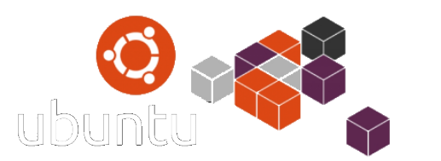
Ubuntu Core/Docker Device Architecture
Field Gateway
Interacting with sensors & business logic
Frequently updates (weekly)
Service
Service
Service
Responsible for IoT Hub & orchestration of services
Often updates (once or twice a month)
Agent
microServiceBus-core
Responsible for communication with mSB.com
Rarely updates (once or twice a year)
Agent
microServiceBus-node
Platform
Node.js
Operating system
Linux | Windows

Slide 24

Yocto Device Architecture
Görlitz enQube
Service
Service
Service
Service
Service
Service
Agent
Agent
microServiceBus-core
microServiceBus-core
Agent
Agent
microServiceBus-node
microServiceBus-node
Platform
Platform
Node.js
Node.js
Yocto Image
Operating system
Operating system
Linux (Yocto)
Linux (Yocto)

Slide 25
microServiceBus.com - Key concepts
Organization
“Subscription” owning flows, services & nodes
Services
Nodes
Cloud connected agent, hosting one or more flows
Code interacting with HW or other services
Inbound service
Outbound service
Other service
Flows
Process execution of services

Slide 26
Demo!
microServiceBus.com - Key concepts

Slide 27



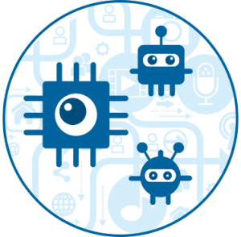






microServiceBus Architecture
IoT Hub
microServiceBus.com
Issue tracking
Sim card mgmt
Field Gateway

